Slide 1
A Comprehensive Scheme for Homomorphic-Encryption-Based Federated Learning System
Reporter:
R11921A16 何秉學
R11922193 張歐華
R11944034 許智翔
B09902060 馮楷

Slide 2
Outline
Background & Motivation
Proposed Methods
Results and Comparisons
Analysis and Discussion
Conclusion
Implementation

Slide 3
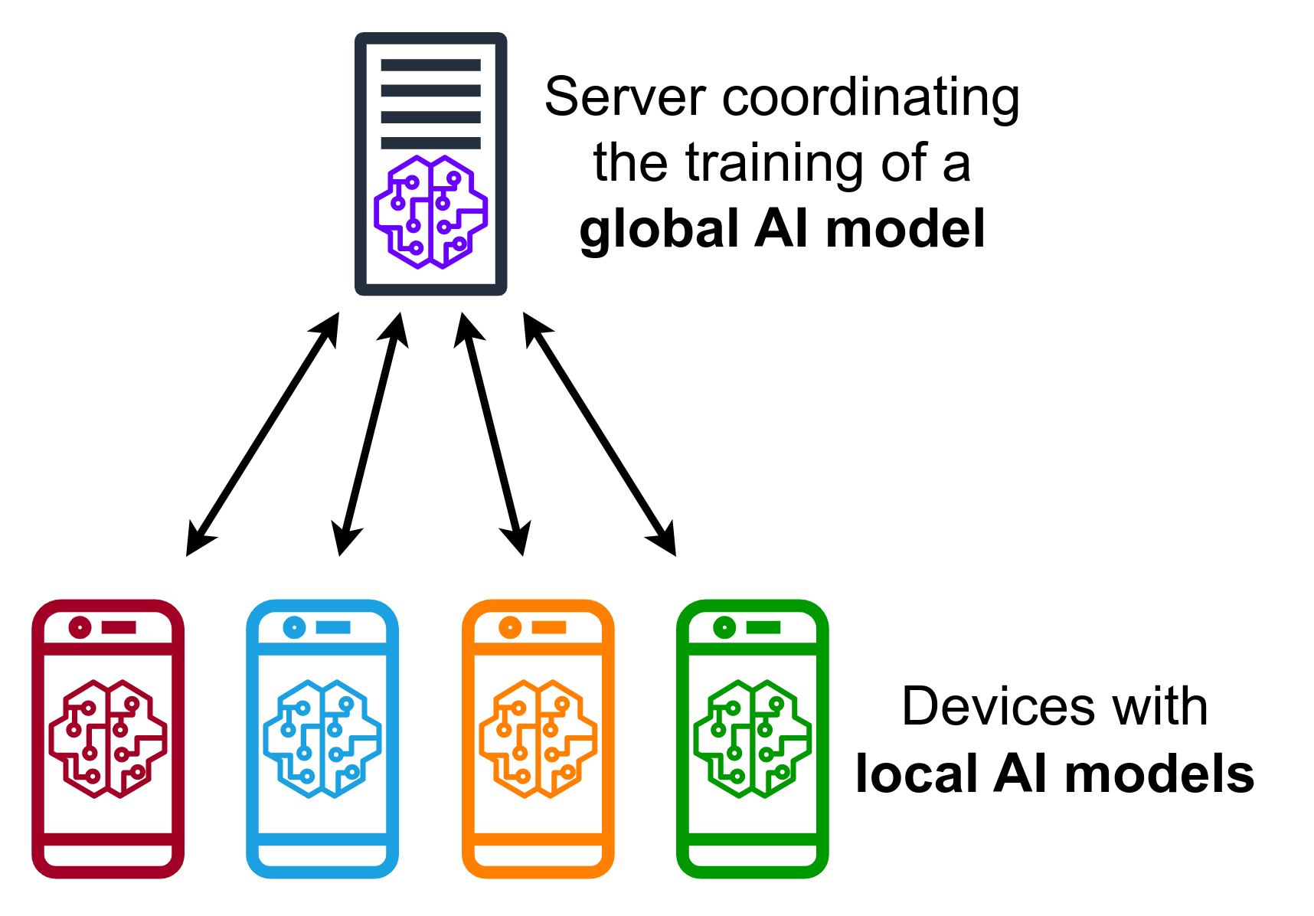
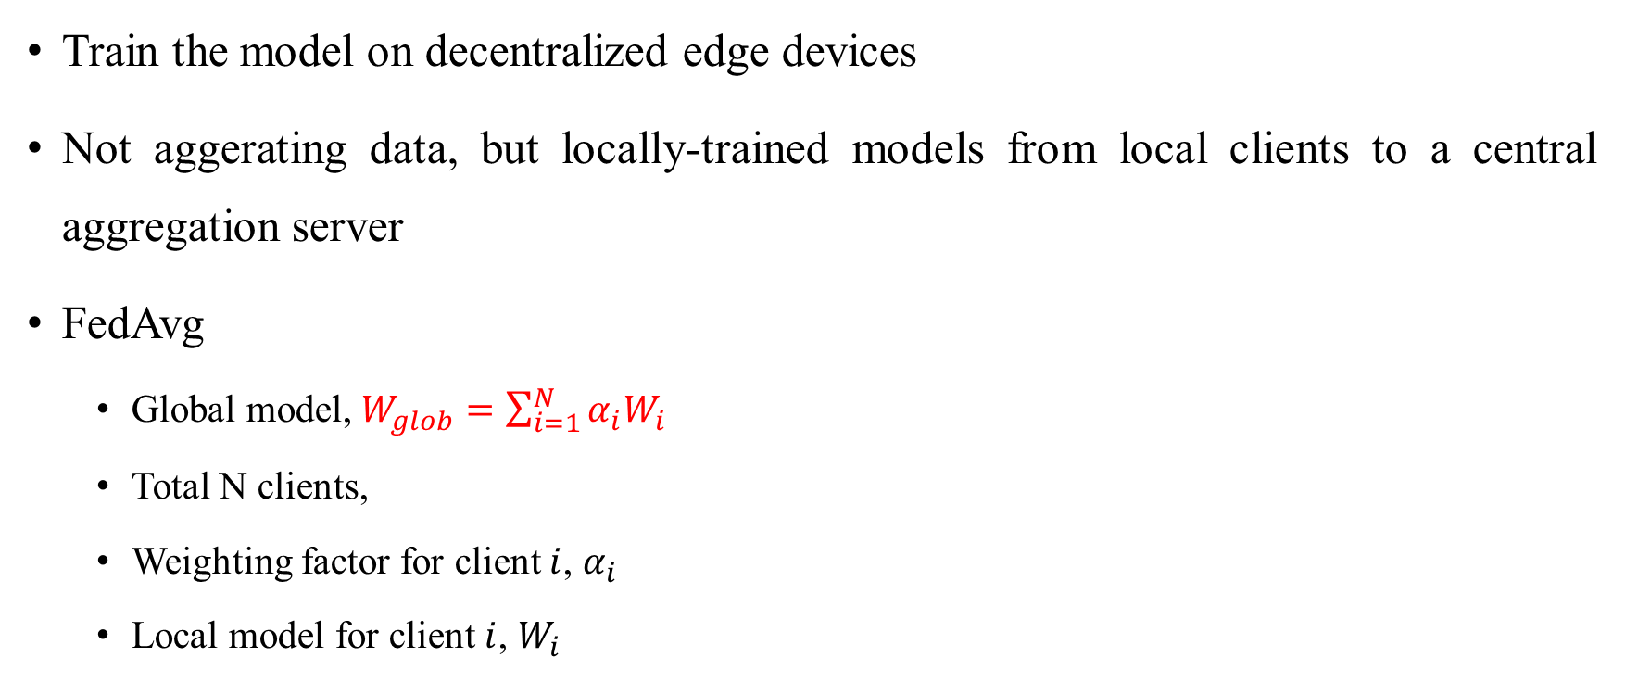
Background & Motivation – Federated Learning
Train the model on decentralized edge devices
Not aggerating data, but locally-trained models from local clients to a central aggregation server
FedAvg
Global model, $W_{glob}=\sum_{i=1}^{N}{α_{i}W_{i}}$
Total N clients,
Weighting factor for client $i$, $α_{i}$
Local model for client $i$, $W_{i}$
Notes:
Keep personal data on clients. Instead of uploading data to the server for centralized training,
clients process their local data and share updated local models with the server.
FedAvg is commonly used on the server to combine client updates and produce a new global model.
At each round, a global model $W_{glob}$ is sent to N client devices. Each client i performs gradient descent on its local data with E local iterations to update the model Wi. The server then does a weighted aggregation of the local models to obtain a new global model, where $α_{i}$ is the weighting factor for client i.
這邊是介紹甚麼是FL，可以想像一個情境，如果是一個大型的醫學研究中心，想要利用病人的病歷資料做訓練，那全台灣有這麼多個醫學中心，我要怎麼做整合和訓練，
傳輸上去的東西是model

Slide 4
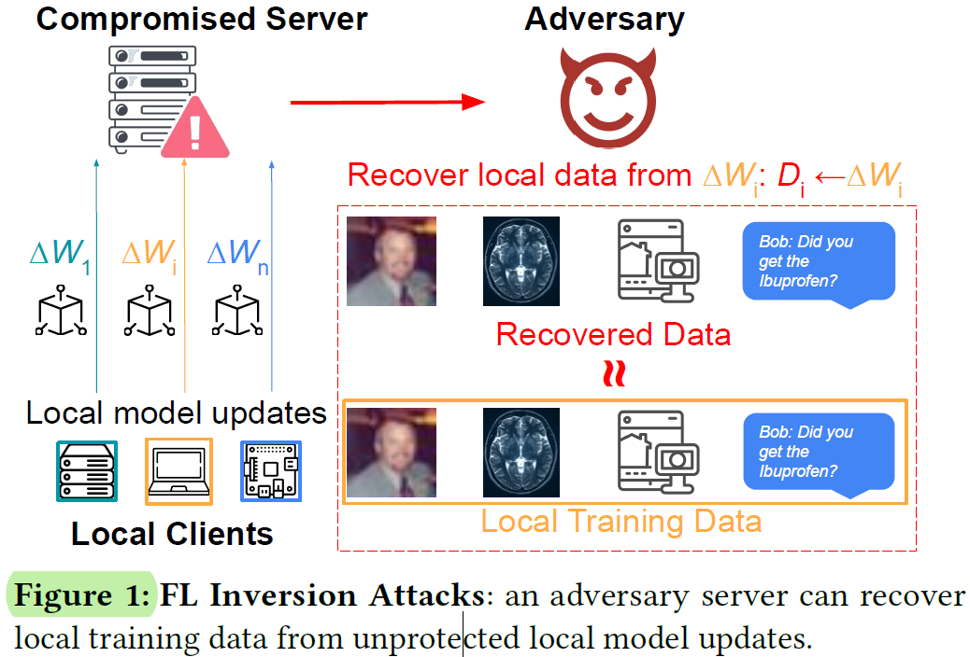
Background & Motivation – Federated Learning
However, sharing local models in plaintext during aggregation poses a privacy vulnerability
Attack (extract private data)
Membership Inference Attacks
Sensitive User Data Recovery Attacks
Notes:
Membership Inference Attacks: 給定一筆資料，測試它是否在 training dataset 之中。
Sensitive User Data Recovery Attacks: 恢復已刪除的文件、備份數據、利用未加密的數據、竊取敏感數據。

Slide 5
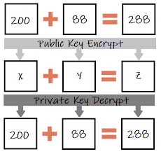
Background & Motivation – Homomorphic Encryption
4 algorithms
KeyGen(λ) > key pair (pk,sk)
Enc(pk,m) > ciphertext message c (plaintext message m)
Eval(c,f) > ciphertext message c’ (function f)
Dec(sk,c’) > plaintext message m’
Cheon-Kim-Kim-Song (CKKS) scheme[2]
[2]https://blog.csdn.net/weixin_43466027/article/details/118792866
Notes:
HE remains a powerful but complex cryptographic foundation with impractical overheads for most real-world applications.
The scalability of encrypted computation and communication during federated training then becomes a bottleneck, restricting its feasibility for real-world edge computing scenarios.
Encrypted computing and communication of large models might take considerably longer than the actual model training (without encryption).

Slide 6
Background & Motivation – Homomorphic Encryption
Encrypt local models during aggregation & Perform model aggregation over ciphertexts
Problem:
Complex Cryptographic Foundation
Bottleneck due to overhead
(~15x increase in both computation and communication)
Solution: HE-based privacy preserving FL system with a universal optimization scheme
Notes:
HE remains a powerful but complex cryptographic foundation with impractical overheads for most real-world applications.
The scalability of encrypted computation and communication during federated training then becomes a bottleneck, restricting its feasibility for real-world edge computing scenarios.
Encrypted computing and communication of large models might take considerably longer than the actual model training (without encryption).
HE 仍然是一個強大但複雜的密碼學基礎，對於大多數現實世界的應用程序來說具有不切實際的開銷。聯邦訓練期間加密計算和通信的可擴展性成為瓶頸，限制了其在現實世界邊緣計算場景中的可行性。大型模型的加密計算和通信可能比實際模型訓練（不加密）花費更長的時間。

Slide 7
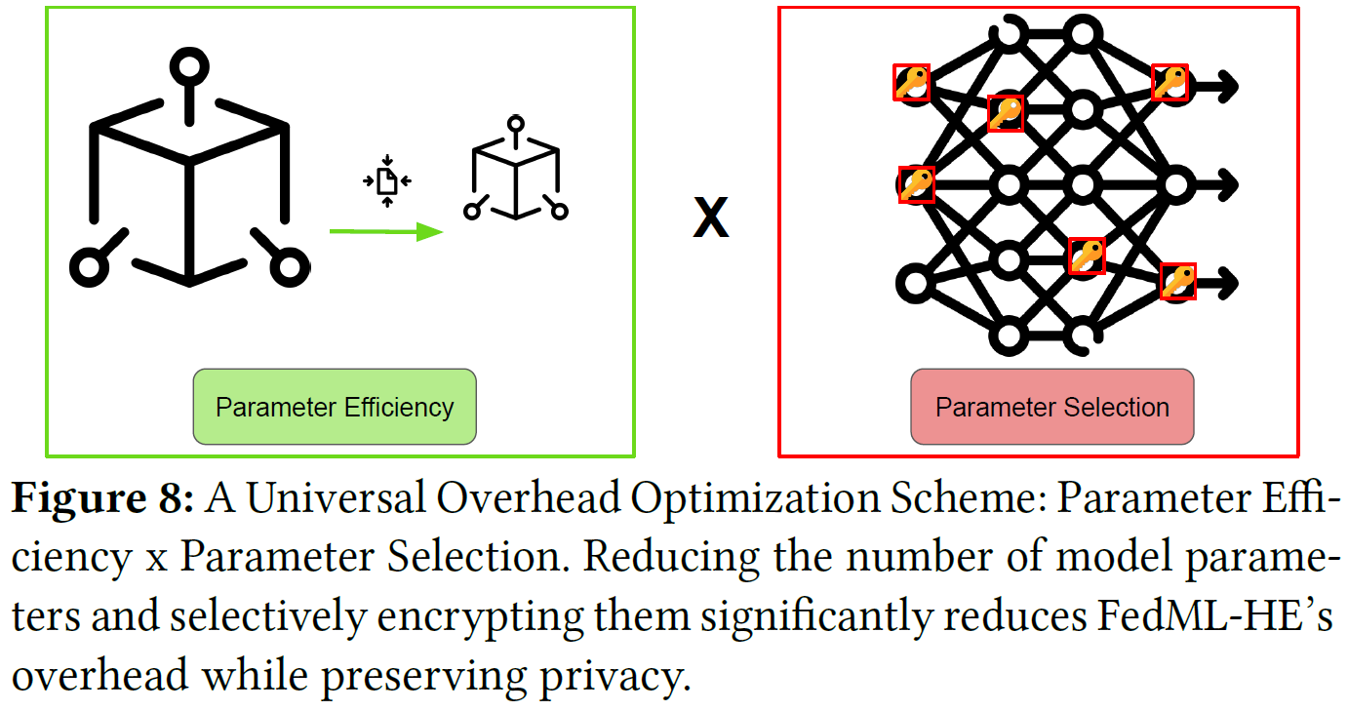
[1] Proposed Methods – Optimization
HE can be optimized in 2 steps
Parameter Efficiency
Reduce the model sizes from an ML perspective
Parameter Selection
Selectively choose a certain portion of the model as inputs for HE functions while the rest of the model undergoes a plaintext aggregation at a certain privacy level.
[1] Jin, W., Yao, Y., Han, S., Joe-Wong, C., Ravi, S., Avestimehr, S., & He, C. (2023). FedML-HE: An Efficient Homomorphic-Encryption-Based Privacy-Preserving Federated Learning System. arXiv preprint arXiv:2303.10837.

Slide 8
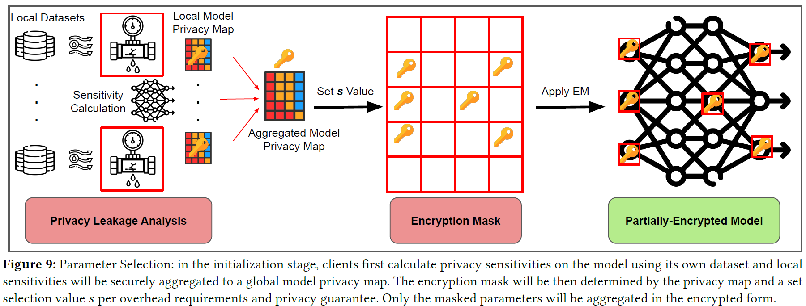
[1] Proposed Methods – Parameter Selection
[1] Jin, W., Yao, Y., Han, S., Joe-Wong, C., Ravi, S., Avestimehr, S., & He, C. (2023). FedML-HE: An Efficient Homomorphic-Encryption-Based Privacy-Preserving Federated Learning System. arXiv preprint arXiv:2303.10837.
Notes:
僅選擇和加密模型中更重要且更容易受到攻擊的部分，以減少 HE 開銷，同時保持隱私保證。 我們使用加密遮罩 (EM) 來有效地選擇加密參數。 EM 的工作原理是首先通過隱私敏感度預先計算模型參數隱私圖，然後應用具有設定隱私閾值的遮罩來選擇參數進行加密，以滿足特定的開銷預期。
參數選擇：在初始化階段，客戶端首先使用自己的數據集計算模型的隱私敏感度，並將局部敏感度安全地聚合到全局模型隱私地圖中。 然後，加密遮罩將由隱私映射和根據開銷要求和隱私保證設置的選擇值 𝑠 確定。 只有屏蔽的參數將以加密形式聚合。
由於每個客戶端的數據分佈可能不同，要讓所有客戶端在不洩露的情況下就某個全局加密掩碼達成一致是一項挑戰
本地數據集，因為本地隱私地圖包含有關客戶端數據的信息。 為了解決這個問題，我們在服務器上對聚合本地隱私地圖進行了加密，這樣就不會洩露有關本地數據的更多私人信息。
在初始化期間，客戶端首先使用自己的本地數據計算本地隱私敏感度，然後服務器將本地敏感度圖聚合為全局隱私圖。 加密掩碼使用隱私開銷閾值 𝑠 配置，然後作為聯邦學習配置的一部分在客戶端之間共享全局隱私圖。

Slide 9
[1] Problem Statement & Solution Candidate
Problem:
Using Same Key Pair to ensure the correctness of federated learning
May cause…
Key leaks → Compromised whole system → CIA is gone
Solution Candidate:
Threshold HE
Proxy re-encryption
Multi-party HE
[1] Jin, W., Yao, Y., Han, S., Joe-Wong, C., Ravi, S., Avestimehr, S., & He, C. (2023). FedML-HE: An Efficient Homomorphic-Encryption-Based Privacy-Preserving Federated Learning System. arXiv preprint arXiv:2303.10837.
Notes:
為了保證聯邦學習的正確性，所有的本地模型都應該使用相同的密鑰對進行加密，這很容易導緻密鑰洩露並危及整個系統。

Slide 10

Candidate 1 – Threshold HE
$THE.KeyGen(1^{λ},1^{L};pp)→(pk, evk, {\{{sk}_{i}\}}_{i∈[n]})$
$THE.Enc\left(pk, m\right)→c$
$THE.Eval\left(eval, f,{\left\{c_{i}\right\}}_{i∈\left[k\right]}\right)→c^{∗}$
$THE.Dec\left({\left\{{sk}_{i}\right\}}_{i∈\left[I\right]}, c\right)→m$
$I⊆\left[n\right] with |I|≥t$
Notes:
Shamir[22]提出了(t; n)-閾值密碼學的概念，其中秘密份額在n方之間分配，超過t個份額就可以成功構建主秘密。根據這一想法，引入了HE的閾值解密概念[23]，[24]，即在所有各方之間分配一個秘密密鑰，當所有各方同意時就可以解密
security parameter $λ$ , depth bound L, ski代表每一個人都有自己的secret key，pk和evk是共用的(evk是evaluation key)
只有超過t個人同意解密才會真的解密

Slide 11
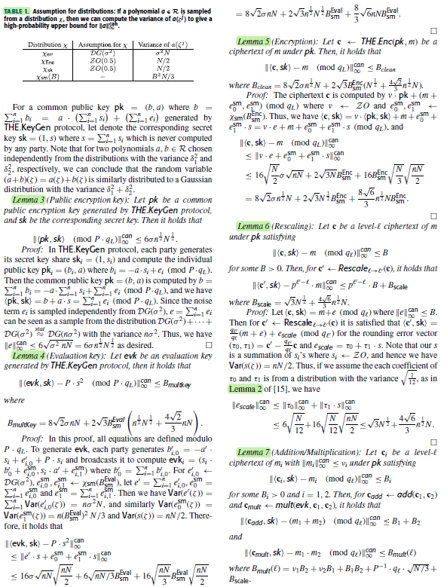
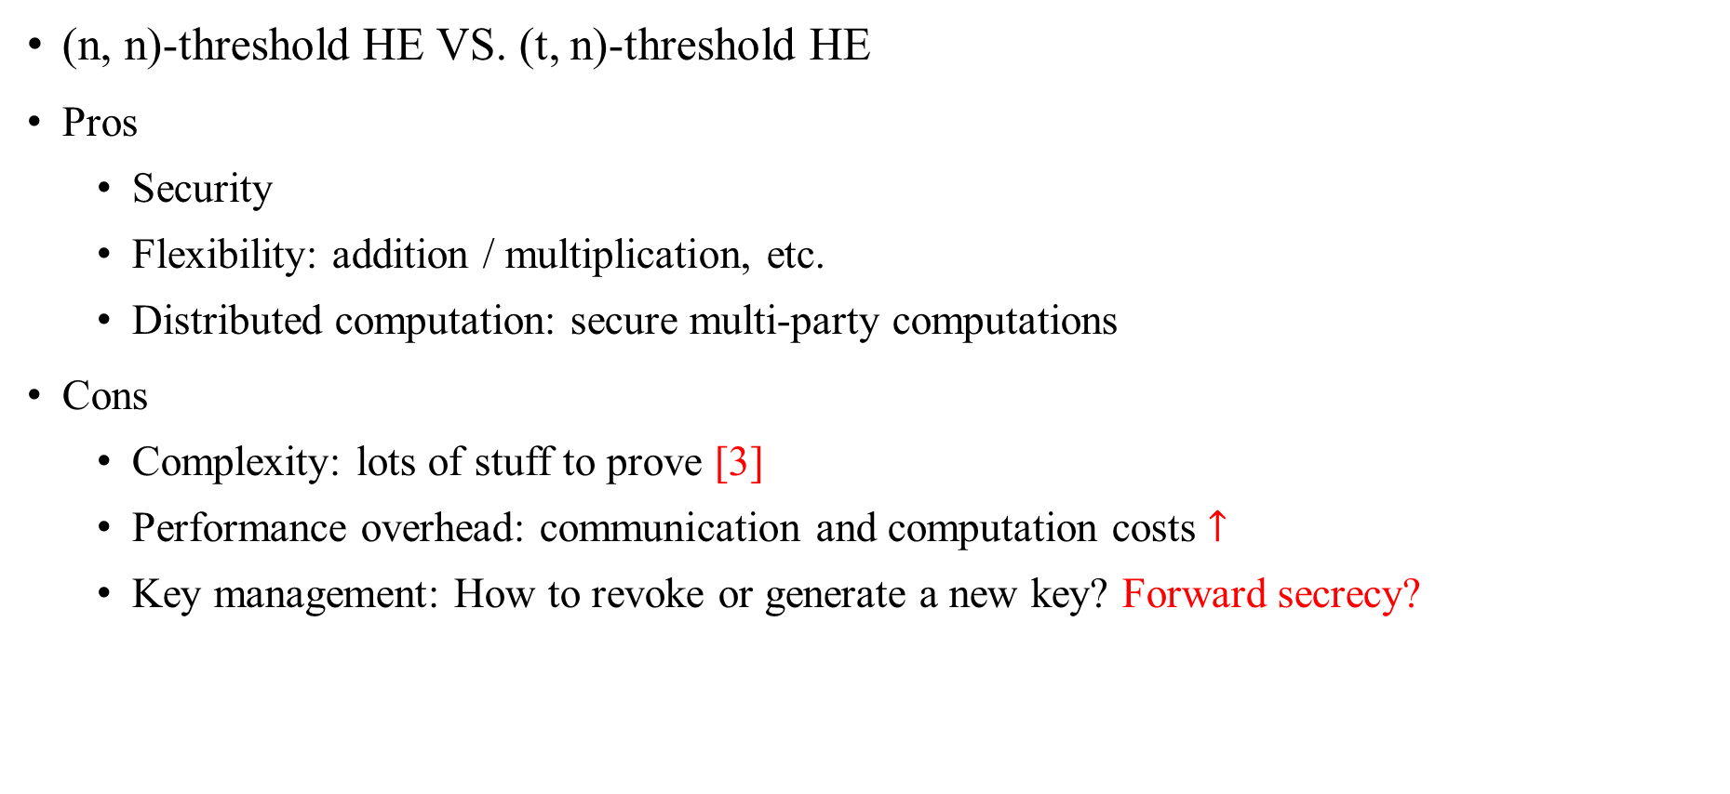
Candidate 1 – Threshold HE
(n, n)-threshold HE VS. (t, n)-threshold HE
Pros
Security
Flexibility: addition / multiplication, etc.
Distributed computation: secure multi-party computations
Cons
Complexity: lots of stuff to prove [3]
Performance overhead: communication and computation costs $↑$
Key management: How to revoke or generate a new key? Forward secrecy?
[3] Kim, E., Jeong, J., Yoon, H., Kim, Y., Cho, J., & Cheon, J. H. (2020). How to securely collaborate on data: Decentralized threshold he and secure key update. IEEE Access, 8, 191319-191329.
Notes:
安全性是最直觀的pros
閾值同態加密支持廣泛的運算，包括加法、乘法以及排序和搜索等更複雜的計算。 這種靈活性使其適用於需要隱私保護計算的各種應用程序。
分散是運算允許高效的並行處理並實現安全的多方計算。

Slide 12
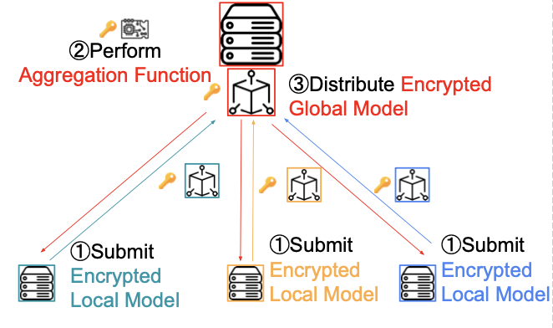
Candidate 2 – Proxy Re-Encryption
Limitation
Requires sharing a key for different local sides to perform computations on its encrypted data

Slide 13
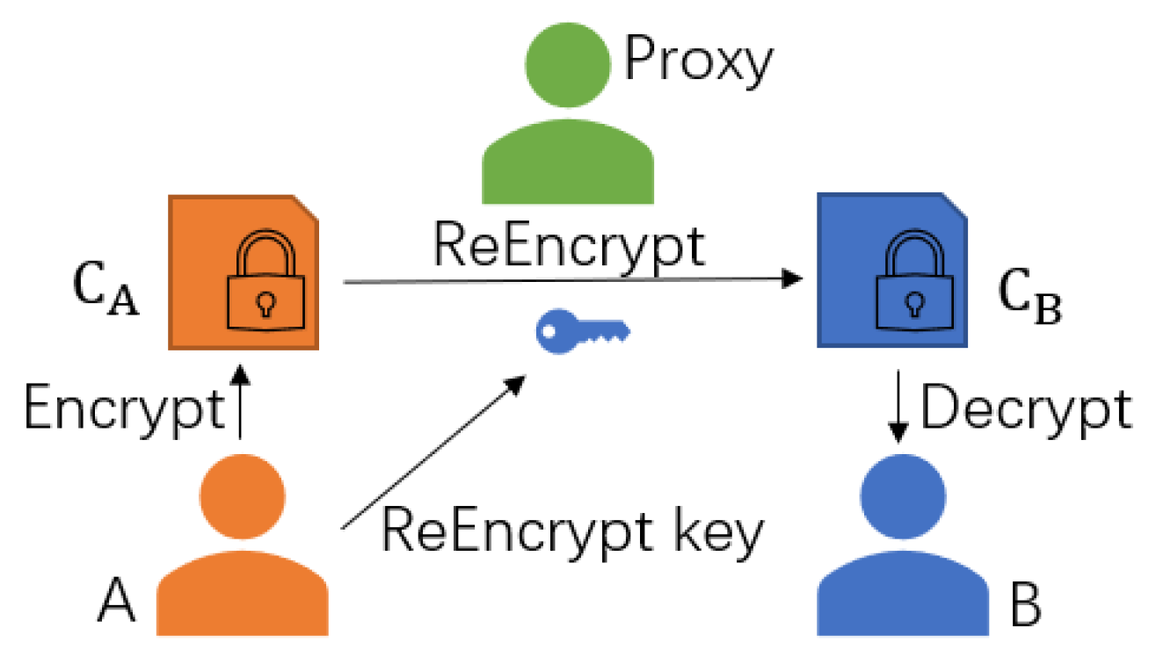
Candidate 2 – Proxy Re-Encryption
Alice
Bob
Notes:
Homomorphic evaluations can only be performed on the ciphertext encrypted under the same key. Participants must establish a common HE key and use it for encryption. In such a situation, privacy can be compromised at the input because each participant can also use the same key to reveal the local model of the other party.
the data provider who has the corresponding private key should either share its key with others or interactively decrypt the evaluated ciphertext us- ing SMPC. However, this results in considerable communication overhead among users. Further- more, the sharing of secret keys with other receivers is undesirable because it enables receivers to decrypt the input ciphertexts before homomorphic evaluation.
proxy re-encryption (PRE) [4] enables a third party to re-encrypt the ciphertext of one key to the ciphertext of another key without decrypting the ciphertext.

Slide 14
Candidate 2 – Proxy Re-Encryption
Homomorphic Proxy Re-Encryption
Support multi-key homomorphic encryption
Can only re-encrypt ciphertext for one receiver at a time, inflexible in FL applications

Slide 15
Candidate 2 – Proxy Re-Encryption
Identity-Based Proxy Re-Encryption
Support multi-key homomorphic encryption
Re-Encryption and homomorphic evaluations only performed once
The participants can obtain global model via their private key

Slide 16
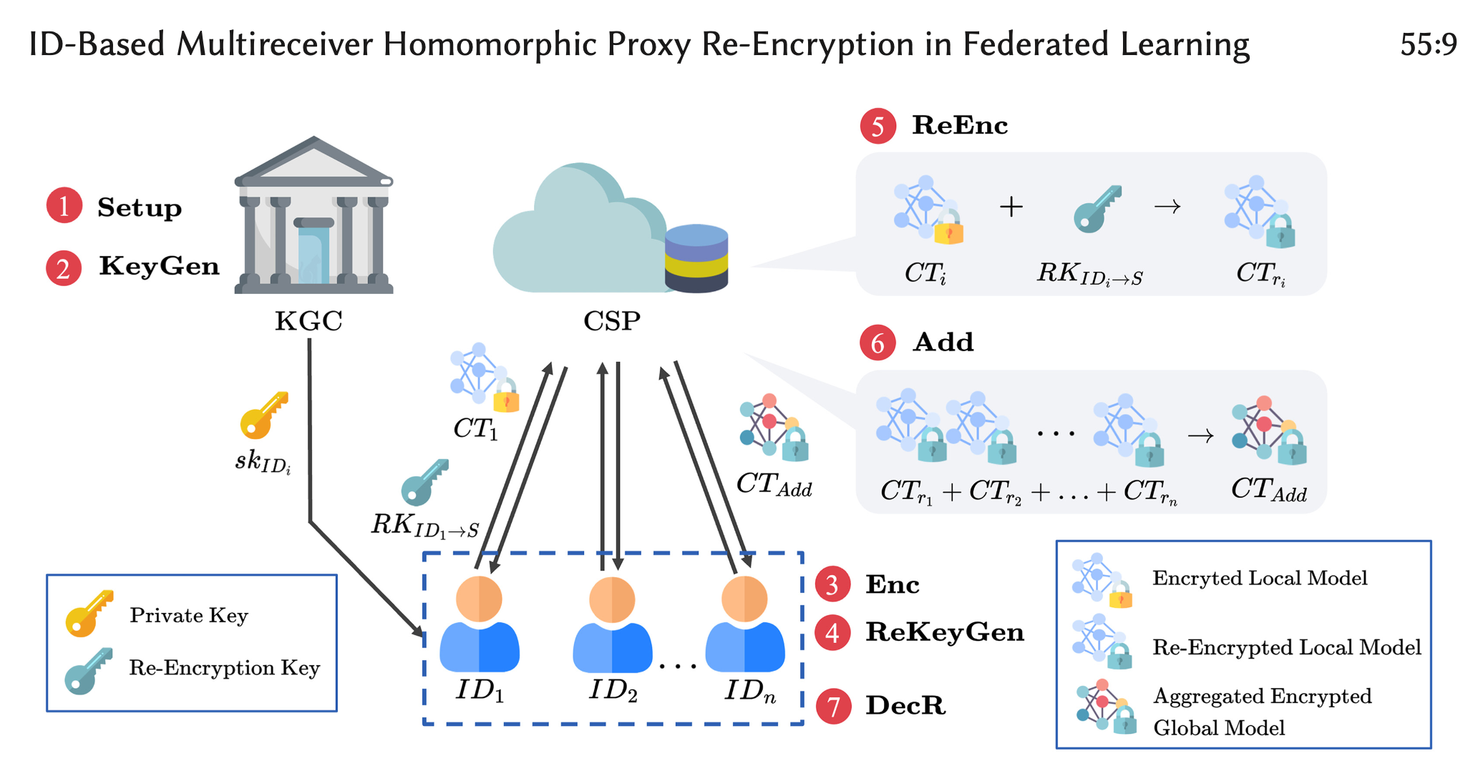
Candidate 2 – Identity-Based

Slide 17
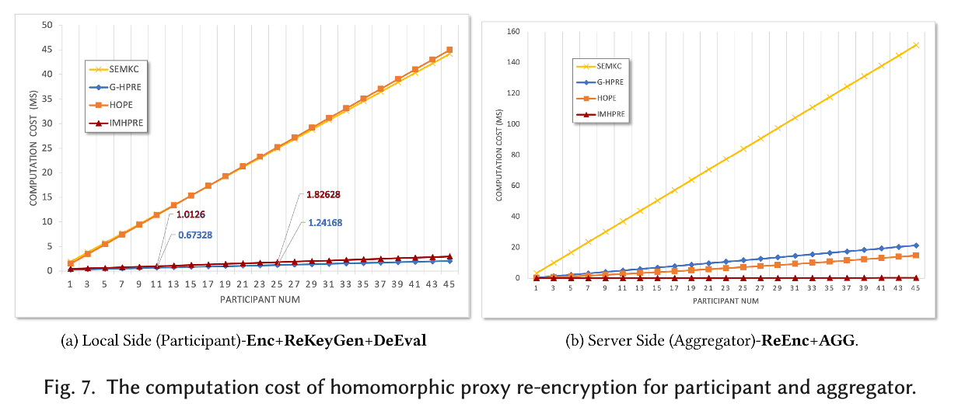
Candidate 2 – Identity-Based

Slide 18
Proposed Method – Multi-party HE
Multi-key homomorphic encryption (MKHE):
N parties(clients) each with its own key pair
Multi-party homomorphic encryption (MPHE):
N key shares → One joint key pair
Multi-group homomorphic encryption (MGHE):
MPHE+MKHE
Notes:
MPHE: 多個 parties 協同生成 joint public key and joint secret key，party 數要在 key gen 前決定，且在運算過程中固定
MKHE: 有彈性，但 ciphertext 與運算複雜度都會隨著 party 變多而上升
在 group 中：MPHE，每一個 group：MKHE

Slide 19
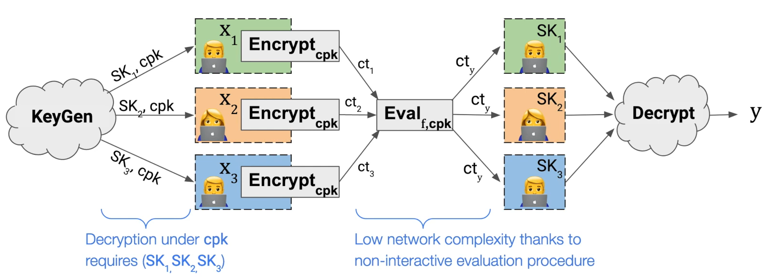
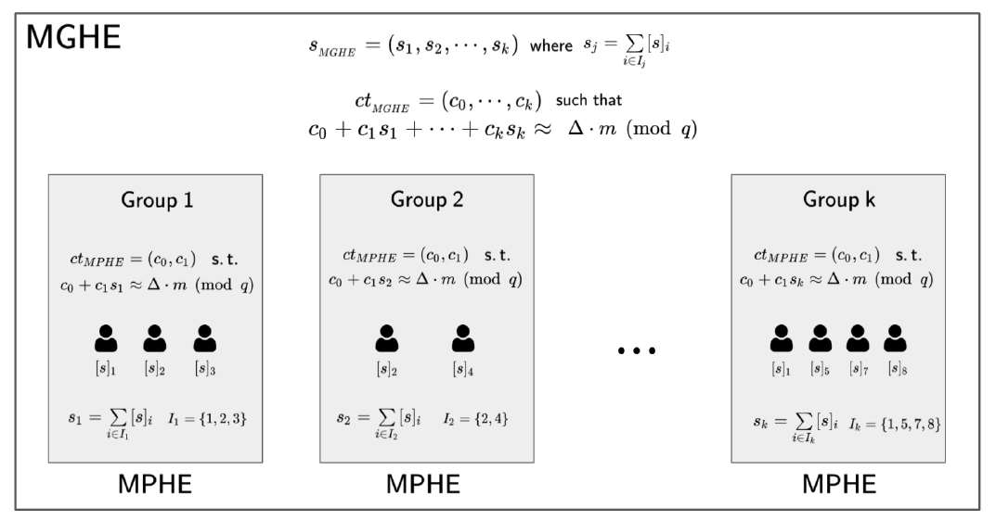
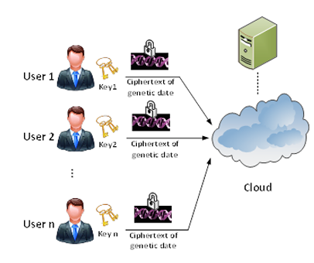
▲ MPHE
▲ MGHE
▲ MKHE
Notes:
MPHE: 多個 parties 協同生成 joint public key and joint secret key，party 數要在 key gen 前決定，且在運算過程中固定
MKHE: 有彈性，但 ciphertext 與運算複雜度都會隨著 party 變多而上升
在 group 中：MPHE，每一個 group：MKHE

Slide 20
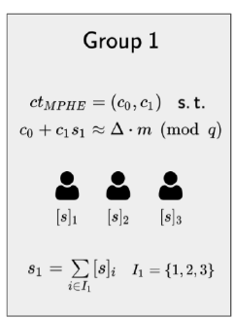
Proposed Method – Multi-party HE
$$MGHE.Enc\left(jek, m\right)→ct$$
Server
$${\overline{ct}}_{add} ← MGHE.Add\left(\overline{ct},\overline{ct}′\right)$$
$${\overline{ct}}_{mul}←MGHE.Mult(jpk_{1},…,jpk_{k};\overline{ct},\overline{ct}′)$$
$${\overline{ct}}_{relin}←MGHE.Relin(jpk_{1},…,jpk_{k};{\overline{ct}}_{mul})$$
Broadcast
$$MGHE.DistDec\left(U_{\left\{1≤j≤k\right\}}{ I}_{j},σ^{′};\overline{ct}\right)$$
$$→m$$

Slide 21
Proposed Method – Multi-party HE
$MGHE.Setup\left(1^{λ};pp\right)→\left(n; p; q;X;α;a; u; h; g\right)$
$MGHE:IndKeyGen\left(i\right)→({\left[sk\right]}_{i}={\left[s\right]}_{i}, {\left[pk\right]}_{i}= \left({\left[b\right]}_{i}; {\left[d\right]}_{i}; {\left[v\right]}_{i}\right)$)
$MGHE:JointKeyGen\left(\left\{{\left[pk\right]}_{i}: i∈I\right\}\right)$
$$→\left(jpk = \left(b; d; v\right),jek = \left(b\left[0\right]; a\left[0\right]\right)\right)$$
$MGHE.Enc\left(jek, m\right)→c_{t}$
$MGHE.Dec(sk_{1},⋯,sk_{k};\overline{ct})→m$
$MGHE.DistDec(U_{\left\{1≤j≤k\right\}}{ I}_{j},σ′;\overline{ct})→m$

Slide 22
Proposed Method – Multi-party HE
Pros
Non-interactive Key Generation
homomorphic operations between ciphertexts under different keys
Cons
Complexity: lots of stuff to prove [1]
Performance overhead: $4k^{2}→2k^{2}+2k$external products
[1] Kwak, H., Lee, D., Song, Y., & Wagh, S. (2021). A unified framework of homomorphic encryption for multiple parties with non-interactive setup. Cryptology ePrint Archive.

Slide 23
Conclusion – Proposed Method
Desired properties
Can be decentralized
Threshold HE and multi-party HE
Can be merged with the scheme for defending poisoning attack
Multi-party HE
We choose multi-party HE in our scheme

Slide 24
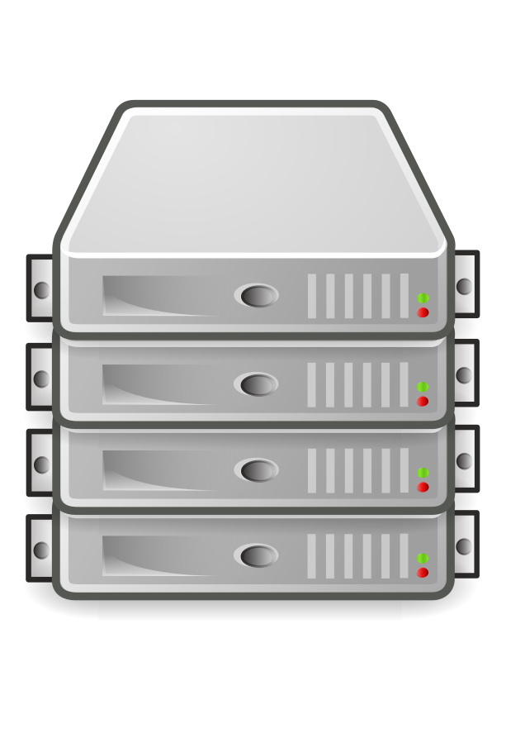






Poisoning Attack
Malicious client can compromise the system by uploading a bad model.
$$M=avg\left(M_{1},M_{2},{M′}_{3}\right)$$
$$M_{1}$$
$$M_{2}$$
$${M′}_{3}$$

Slide 25













Poisoning Attack
Validation process (existing a malicious client)
$${M′}^{(t)}=avg\left(M_{1}^{(t)},M_{2}^{(t)},{M′}_{3}^{(t)}\right)$$
$${M′}^{(t)}$$
Poisoning attack!
$$M_{1}^{\left(t+1\right)}, X$$
$$M_{3}^{\left(t+1\right)}, O$$
$$M_{1}^{(t)}$$
$$M_{2}^{(t)}$$
$${M′}_{3}^{(t)}$$
$$M^{(t)}$$
$$M^{(t)}$$
$$M^{(t)}$$
$$M_{2}^{\left(t+1\right)}, X$$
$$D_{1}$$
$$D_{2}$$
$$D_{3}$$
[IEEE 2021] BaFFLe: Backdoor Detection via Feedback-based Federated Learning

Slide 26
Poisoning Attack
Pros
Validation process is independent of schemes. Easy to deploy.
Cons
Failed when more than half of clients are malicious. (51% attack)
Unable to specify malicious clients.

Slide 27










Aggregated Workflow
Starting a new round
Sending back the result of last model.
Decrypting models
Encrypting local models
Validation
Model update
$$Enc_{pk}(M^{\left(t−1\right)})$$
$$Enc_{pk}(M^{\left(t−1\right)})$$
Group 0
$$s_{0}, pk_{0}, I_{0}=\{0,2,4\}$$
Group 1
$$s_{1}, pk_{1},I_{1}=\{1,2,3\}$$
$${[s]}_{0}$$
$${\left[s\right]}_{2}$$
$${\left[s\right]}_{4}$$
$${\left[s\right]}_{1}$$
$${\left[s\right]}_{2}$$
$${\left[s\right]}_{3}$$

Slide 28








Aggregated Workflow
Starting a new round
Decrypting models
Encrypting local models
Validation
Model update
$$Enc_{pk}(M^{\left(t−1\right)})$$
$$Enc_{pk}(M^{\left(t−1\right)})$$
Group 0
$$s_{0}, pk_{0}, I_{0}=\{0,2,4\}$$
Group 1
$$s_{1}, pk_{1},I_{1}=\{1,2,3\}$$
$$M^{(t−1)}$$
$$M^{(t−1)}$$
$$M^{(t−1)}$$
$$M^{(t−1)}$$
$$M^{(t−1)}$$
$$M^{(t−1)}$$
$${[s]}_{0}$$
$${\left[s\right]}_{2}$$
$${\left[s\right]}_{4}$$
$${\left[s\right]}_{1}$$
$${\left[s\right]}_{2}$$
$${\left[s\right]}_{3}$$

Slide 29








Aggregated Workflow
Starting a new round
Decrypting models
Encrypting local models
Only important weights are encrypted
Validation
Model update
$$Enc_{pk_{0}}\left(M_{0}^{\left(t\right)}\right)$$
$$Enc_{{pk}_{1}}\left(M_{1}^{\left(t\right)}\right)$$
Group 0
$$s_{0}, pk_{0}, I_{0}=\{0,2,4\}$$
Group 1
$$s_{1}, pk_{1},I_{1}=\{1,2,3\}$$
$$M_{0,0}^{(t)}$$
$$M_{0,2}^{(t)}$$
$$M_{0,4}^{(t)}$$
$$M_{1,1}^{(t)}$$
$$M_{1,2}^{(t)}$$
$$M_{1,3}^{(t)}$$
$${[s]}_{0}$$
$${\left[s\right]}_{2}$$
$${\left[s\right]}_{4}$$
$${\left[s\right]}_{1}$$
$${\left[s\right]}_{2}$$
$${\left[s\right]}_{3}$$

Slide 30


Aggregated Workflow
Starting a new round
Decrypting models
Encrypting local models
Validation
Validating group model from previous state
Model update
Group 0
$$s_{0}, pk_{0}, I_{0}=\{0,2,4\}$$
Group 1
$$s_{1}, pk_{1},I_{1}=\{1,2,3\}$$
$$Enc_{pk_{0}}\left(M_{0}^{\left(t−1\right)}\right)$$
$$Enc_{pk_{1}}\left(M_{1}^{\left(t−1\right)}\right)$$
O
O
O
X
X
O
$${[s]}_{0}$$
$${\left[s\right]}_{2}$$
$${\left[s\right]}_{4}$$
$${\left[s\right]}_{1}$$
$${\left[s\right]}_{2}$$
$${\left[s\right]}_{3}$$

Slide 31

Aggregated Workflow
Starting a new round
Decrypting models
Encrypting local models
Validation
Model update
$$Enc_{pk}\left(M^{(t)}\right)=Enc_{{pk}_{0}}(M_{0}^{(t)})$$
$$Enc_{pk_{0}}\left(M_{0}^{\left(t\right)}\right)$$
Group 0
$$s_{0}, pk_{0}, I_{0}=\{0,2,4\}$$
$$M_{0,0}^{(t)}$$
$$M_{0,2}^{(t)}$$
$$M_{0,4}^{(t)}$$
O
O
O
$${[s]}_{0}$$
$${\left[s\right]}_{2}$$
$${\left[s\right]}_{4}$$

Slide 32
Q&A
Thank you

